Slide 1
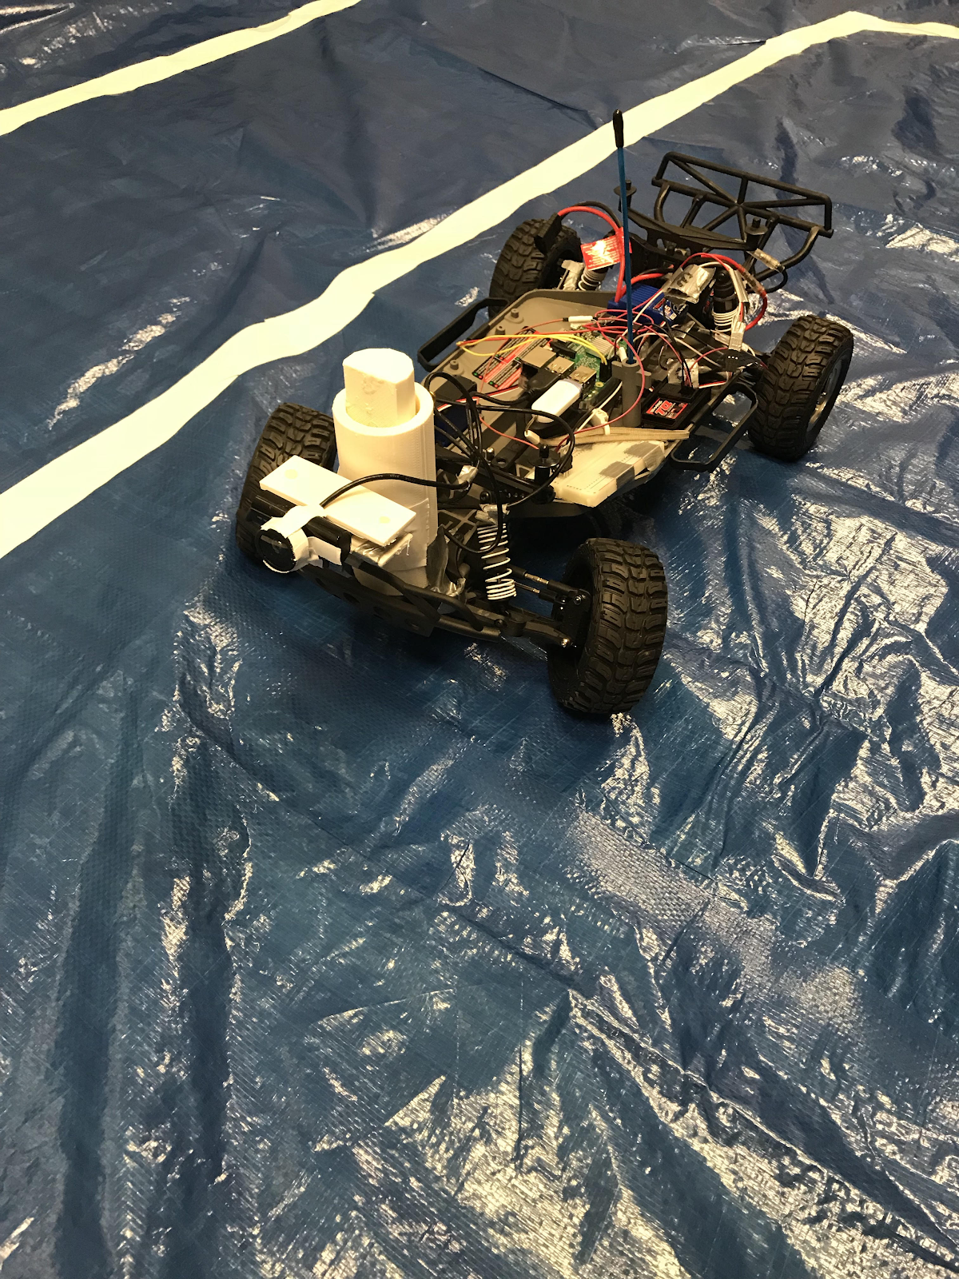
RC Car Mobile App Controller
Date: 12/6/2018
Project Team Members: Matthew Burruss and Gaby Gallego
Class: EECE 4371

Slide 2
Overview of Project
Deliverables
A RC car that can be controlled by an Android Application.
The RC car is controlled by a Raspberry Pi 3 which collects images from a USB webcam
The Raspberry Pi 3 sends images to the client application which displays the live feed in a window
The client sends controls (acceleration and steering duty cycles) to the Raspberry Pi 3 which is used to control the GPIO pins that ultimately control the steering servos and the acceleration motor.
The application has a password protected text field. Only clients with the appropriate VIEW password can view the images collected by the Raspberry Pi 3 and only clients with the appropriate CONTROL password can control the RC Car.
The application has a third text field that controls what type of image is sent to the application. The configurations supported are CARTOON mode, LANE DETECTION mode, and normal mode i.e. unfiltered images.
The client/server communication paradigm uses UDP/IP.
The client and the server are multi-threaded applications

Slide 3
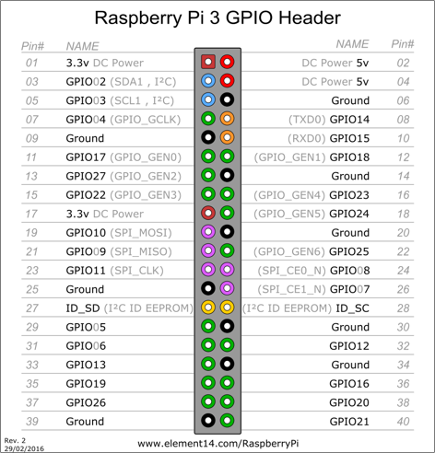
Hardware Architecture
Hardware Components
Traxxas Slash 2WD RC Car (provided by Vanderbilt’s Institute for Software Integrated Systems (ISIS))
Raspberry Pi 3
USB Webcam
Wide eye lens
Connector wires
5V 1A Battery Pack to power Raspberry Pi 3
8.4 V NiMH battery to power Traxxas RC Car
PWM
Pulse Width Modulation is used to control the steering servos and the acceleration motor
Frequency: 100 Hz
Duty cycle: [10,20]
Steering: left ~= 10 and right ~= 20
Acceleration: not moving ~= 15, moving 1 m/s ~= 16

Slide 4
Server Software Architecture
The server runs 2 threads: Data thread and camera thread
The data thread receives images with the following format
“PASSWORD=XXXXX;ACCELERATION=XXXXXX;STEERING=XXXXXX”
The password is verified before setting the appropriate GPIO PWM signals
The camera thread uses OpenCV, an open source image processing toolbox, to control the camera and configure its parameters
The camera captures images every 0.33 seconds.
The thread receives a message with the following format
“PASSWORD=XXXXXXX;TYPE=XXXXX”
The password is verified before sending the image over and processing the image if DETECT LANE or CARTOON are sent as the type.
OpenCV is used to process the images.

Slide 5
Android Client Architecture
UI Components
An ImageView, EditText fields x3, SeekBar x2
AsyncTask used as data sender and image receiver.
A runnable controls timed operations to call the AsyncTasks
The seekbars are normalized to produce the proper duty cycles
The textfields are used to control the configuration and allow the user to enter a password for both the image viewer and the controller.

Slide 6
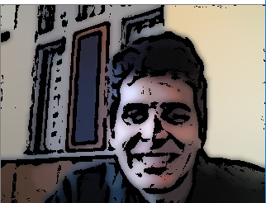

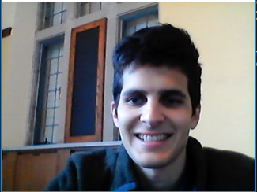
Modes of Operation
The user can configure the live feed to perform image processing
Supported configurations: cartoon mode (CARTOON) and lane detection (DETECT LANE)
It is not required to be in finance class to use CARTOON mode.
CARTOON mode
DETECT LANE mode
Normal operational mode

Slide 7
Questions?

